Slide 1
PROJECT 3: CIFAR-10 Dataset Classification
CSCI-6450: Machine Learning
Done by Kundan and Chirag

Slide 2
Contribution
Slides: Sai Kundan Suddapalli
Code: Sai Kundan Suddapalli
Documentation/Report: Chirag Simha

Slide 3
About CIFAR-10 Dataset
The CIFAR-10 dataset is a collection of 60,000 32x32 color images, categorized into 10 classes, with 6,000 images per class. It's widely used for benchmarking machine learning models in image classification tasks. This dataset's balanced classes and manageable size make it a popular choice for both learning and research.

Slide 4
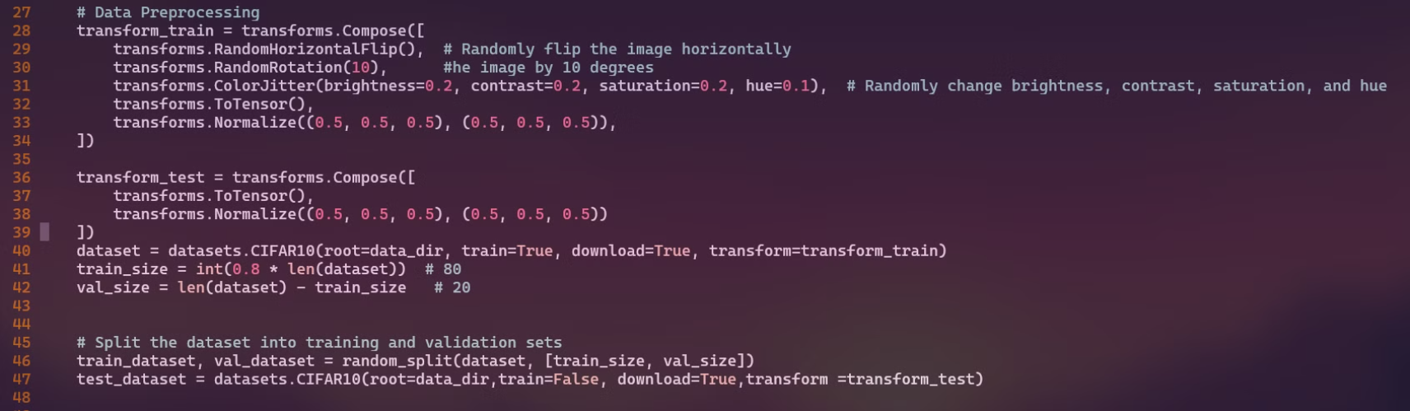
Data Preprocessing & Argumentation
The CIFAR-10 dataset was split into 80% training and 20% validation sets. Images were normalized for preprocessing.
To improve model robustness and generalization, we used image augmentation. This included random horizontal flips (10% probability), rotations, and color jittering (adjusting saturation, brightness, and contrast).

Slide 5
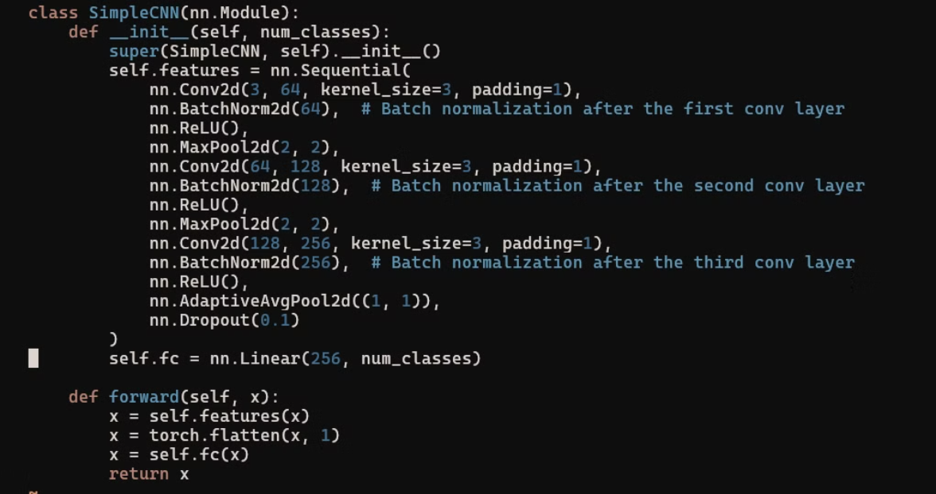
Model Architecture 1 : Simple CNN

Slide 6
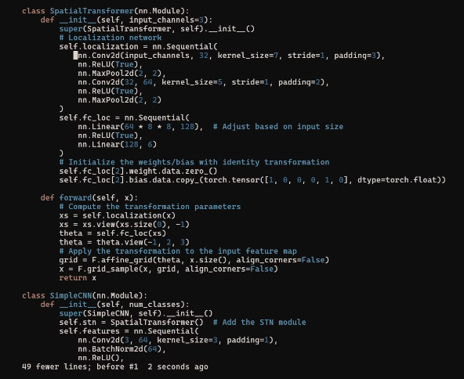
Model Architecture 2: STN + Simple CNN
This model improves image classification by using a Spatial Transformer Network (STN) to align images before a Simple CNN classifies them.
Components:
STN: Extracts features; predicts alignment; applies transformation.
Simple CNN: Extracts features from the aligned image and classifies.
Overview
Input image to STN.
STN aligns the image.
Aligned image to CNN.
CNN classifies the image.

Slide 7
Optimizer and Cross-Entropy Loss
Both Adam and SGD optimizers were used.
Adam yielded better results

Slide 8
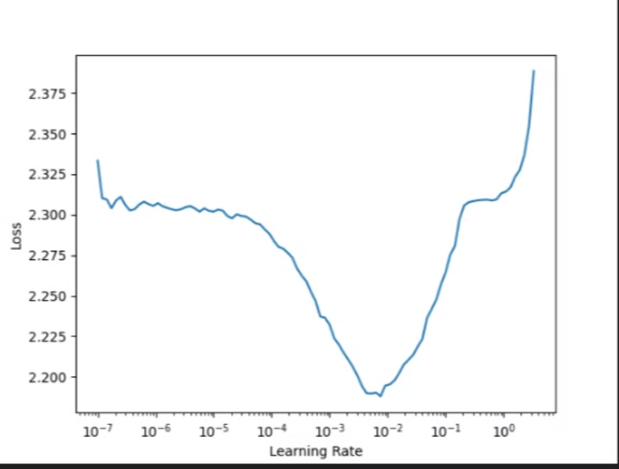
Efficient Learning Rate
We utilized the FastAI library, which automatically determines an optimal learning rate for the model and cross-entropy function. The resulting learning rate was 1e-3.

Slide 9
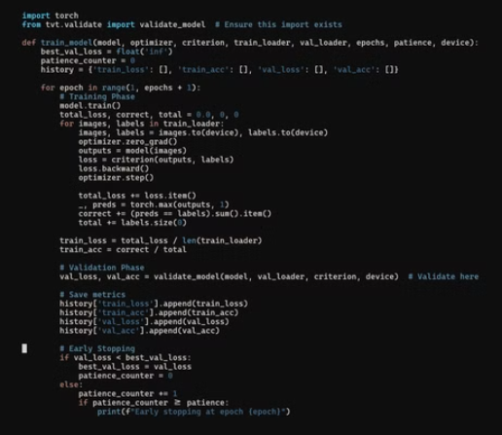
Training
we used Early stop patience 15 Batch_size = 128 , epochs = 2000 , learning rate =1e-3 /0.001 ,patience = 50 for combo
Batch_size = 64, epochs = 1000 , learning rate =1e-2 /0.01 , patience = 15 for Simple CNN

Slide 10
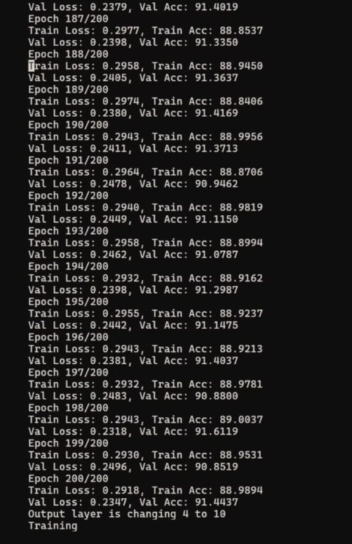
Pretext Task
To enhance model accuracy, we incorporated an image rotation pretext task. The model was trained to classify images rotated by 0, 90, 180, and 270 degrees, forcing it to learn rotation-invariant features.
epocs of 200

Slide 11
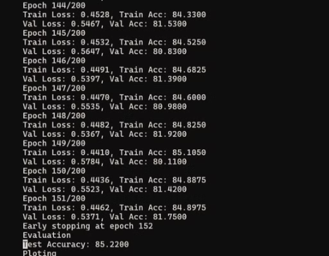
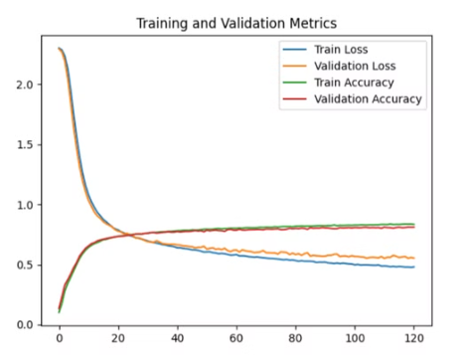
Results with Simple CNN
85%
Test Accuracy

Slide 12
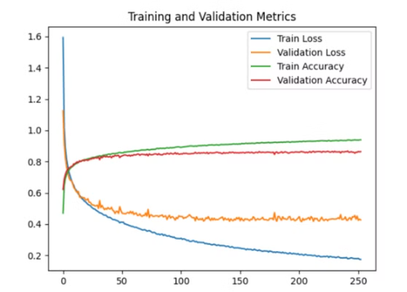
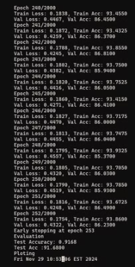
Results with Combo architecture
91%
Test Accuracy

Slide 13

Q&A
We welcome your questions and look forward to discussing this further.

